Slide 1
Stochastic Threshold to Unify Space and Time in Action Selection
Geoffrey Mégardon
2017

Slide 2
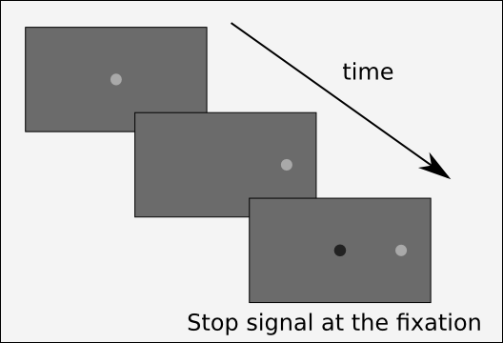
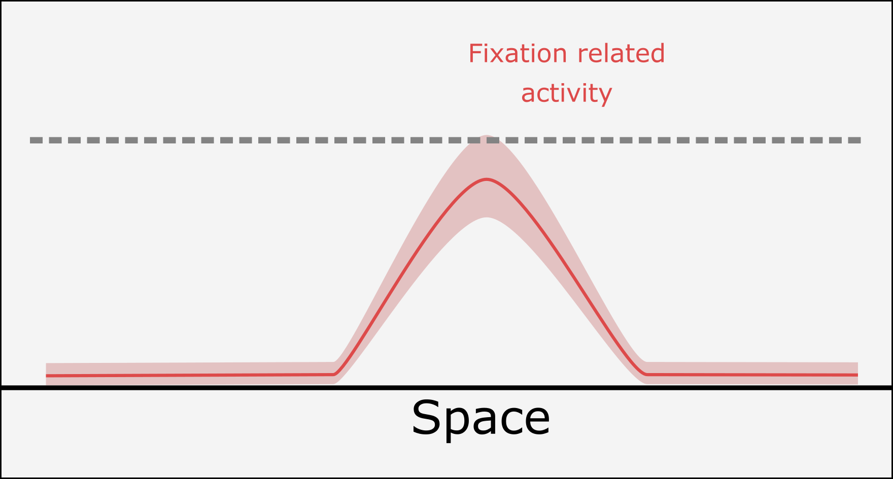
Unifying micro and macro-saccade
DINASAUR and Annie’s experiment

Slide 3
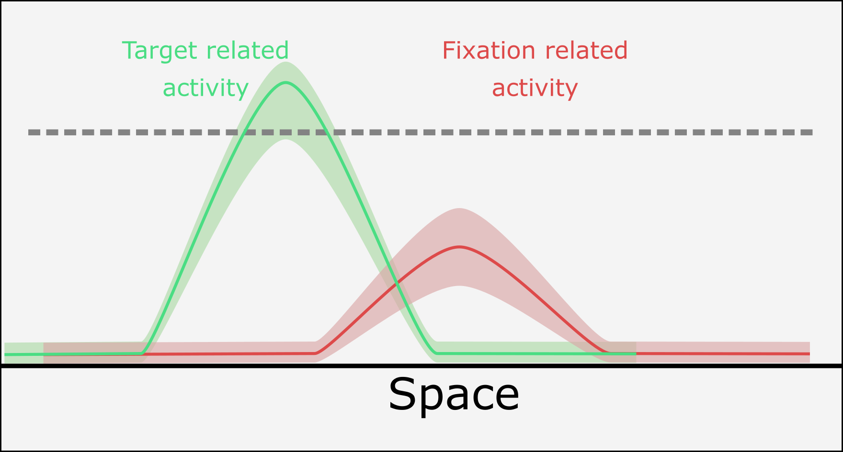
Unifying micro and macro-saccade
DINASAUR and Annie’s experiment

Slide 4
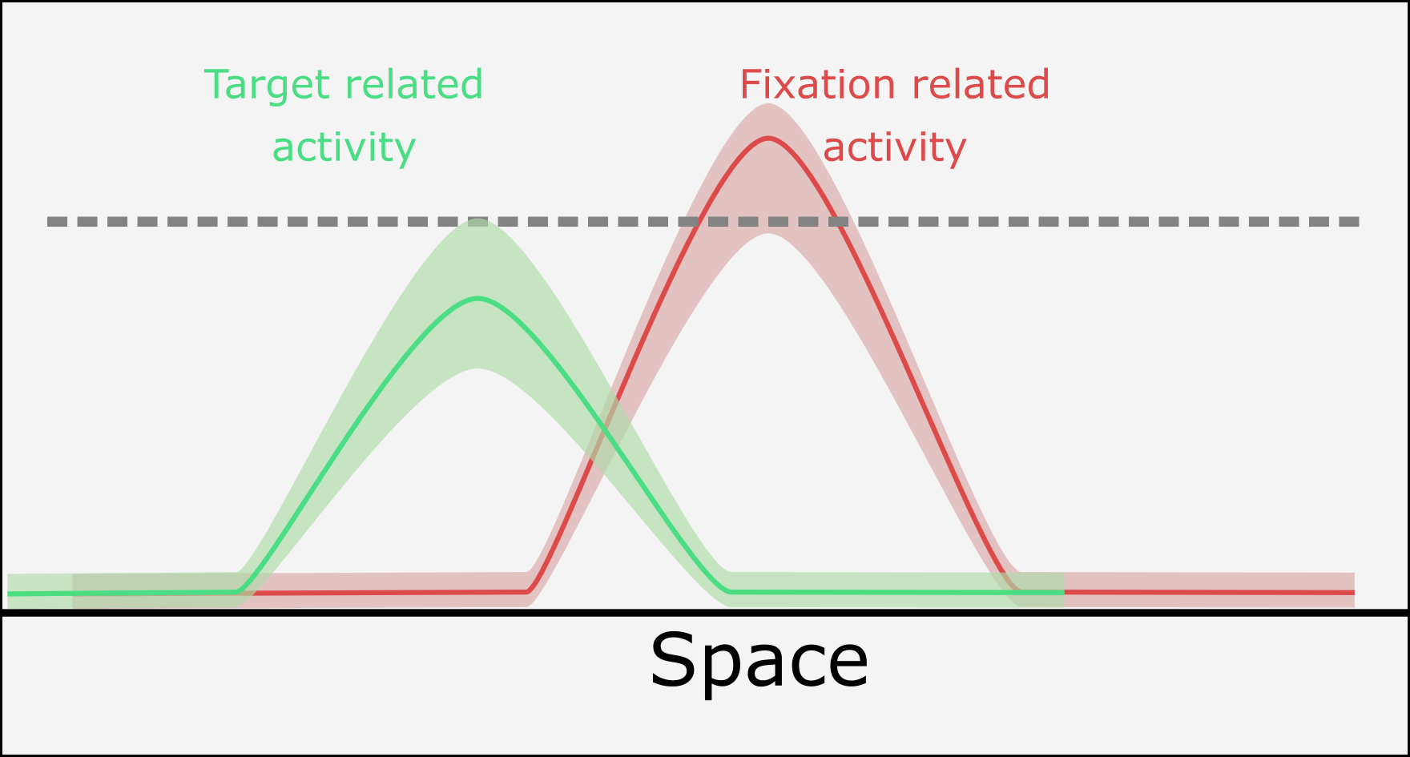
Unifying micro and macro-saccade
DINASAUR and Annie’s experiment

Slide 5
Unifying micro and macro-saccade
DINASAUR and Annie’s experiment

Slide 6
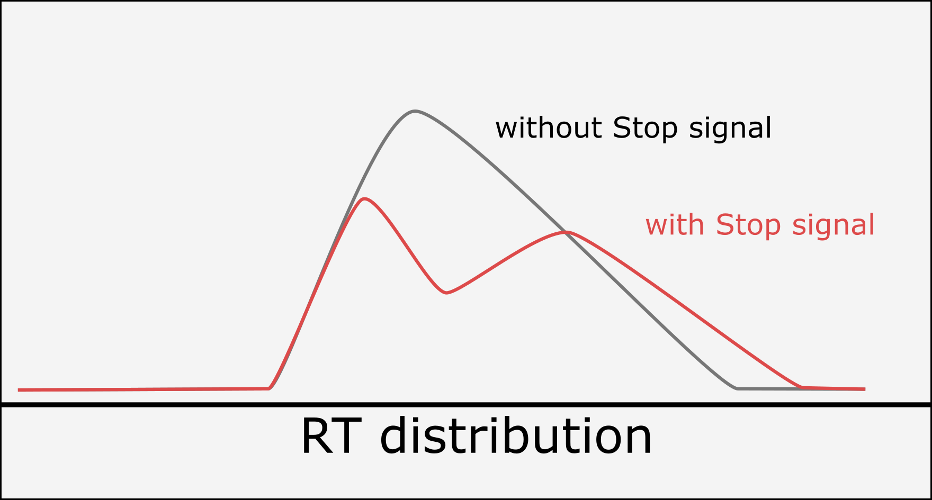
Unifying micro and macro-saccade
DINASAUR and Annie’s experiment
time

Slide 7
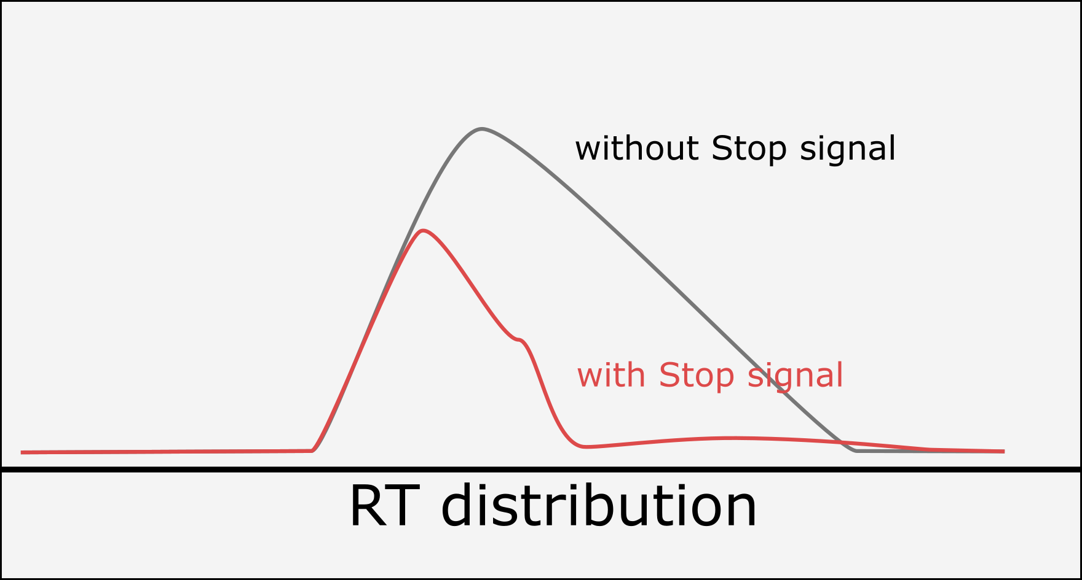
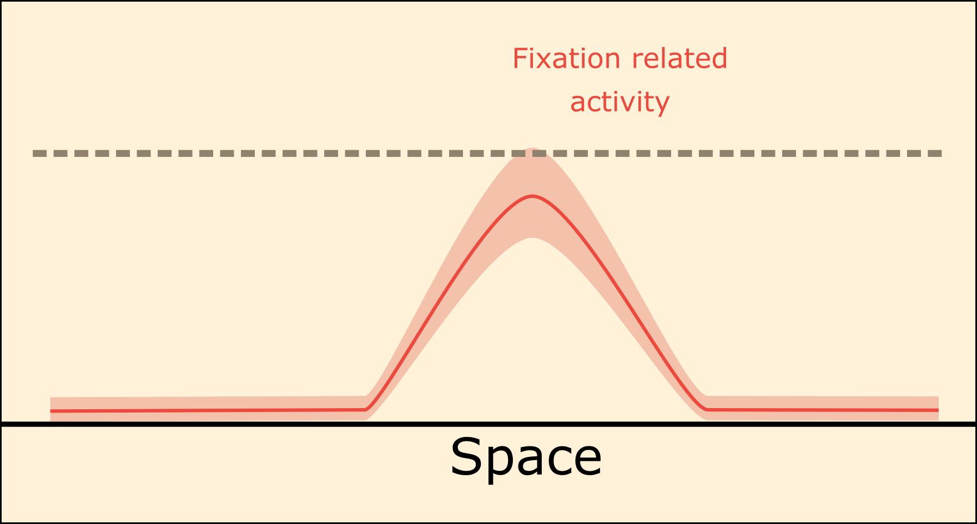
Unifying micro and macro-saccade
DINASAUR and Annie’s experiment
TOP DOWN
time

Slide 8

Unifying micro and macro-saccade
DINASAUR and Annie’s experiment
OK, that is good, but …
DINASAUR is made to:
trigger a saccade whenever the threshold in passed
trigger only one saccade per trial
P(Saccade) > 0
time

Slide 9

Unifying micro and macro-saccade
DINASAUR and Annie’s experiment
Solution?

Slide 10
Unifying micro and macro-saccade
In fact the fixational part of DINASAUR was already ignored in the original papers
Bompas and Sumner, 2011
Trappenberg, 2001
All the Reaction times (Target/Distractor) were taken only from the blue interval

Slide 11
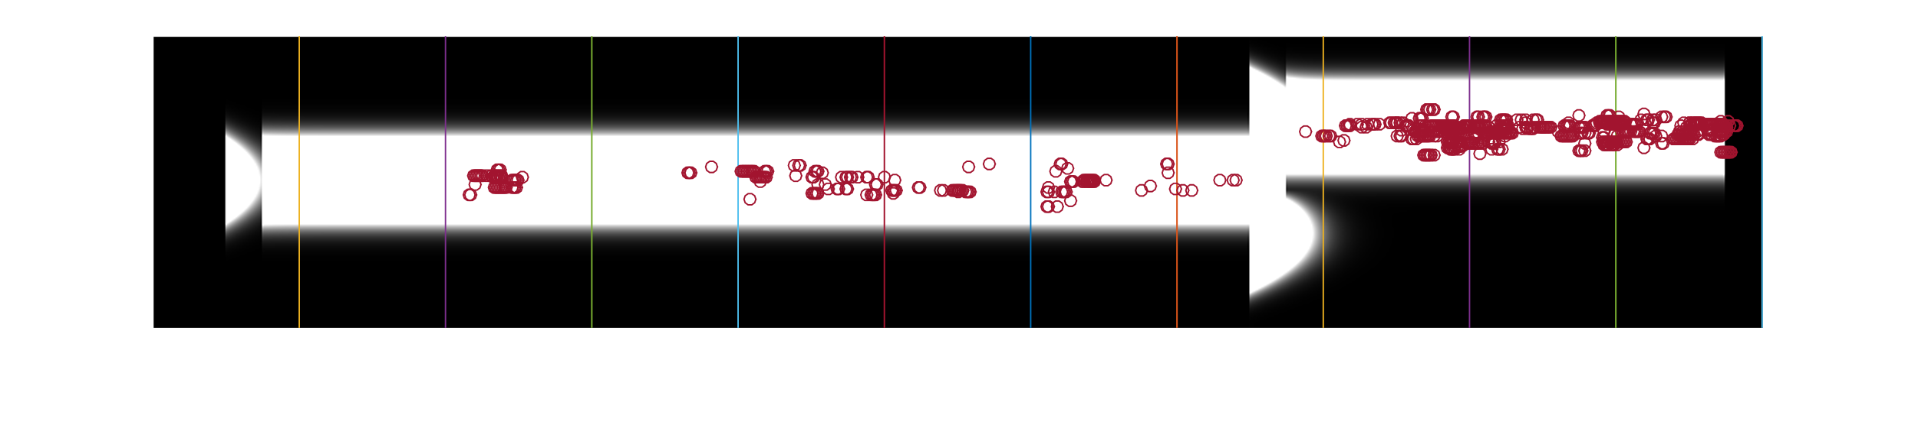
Unifying micro and macro-saccade
The noise is so strong that it would have triggered micro-saccades on the fixation way before target presentation
One trial simulation of DINASAUR
Target
Fixation
Space (nodes)
Distractor
Time (ms)
Reported
in Bompas and Sumner, 2011
Actual first saccades
in Bompas and Sumner, 2011

Slide 12
Unifying micro and macro-saccade
Is ignoring the fixation part when modelling saccade
generation a good solution?

Slide 13
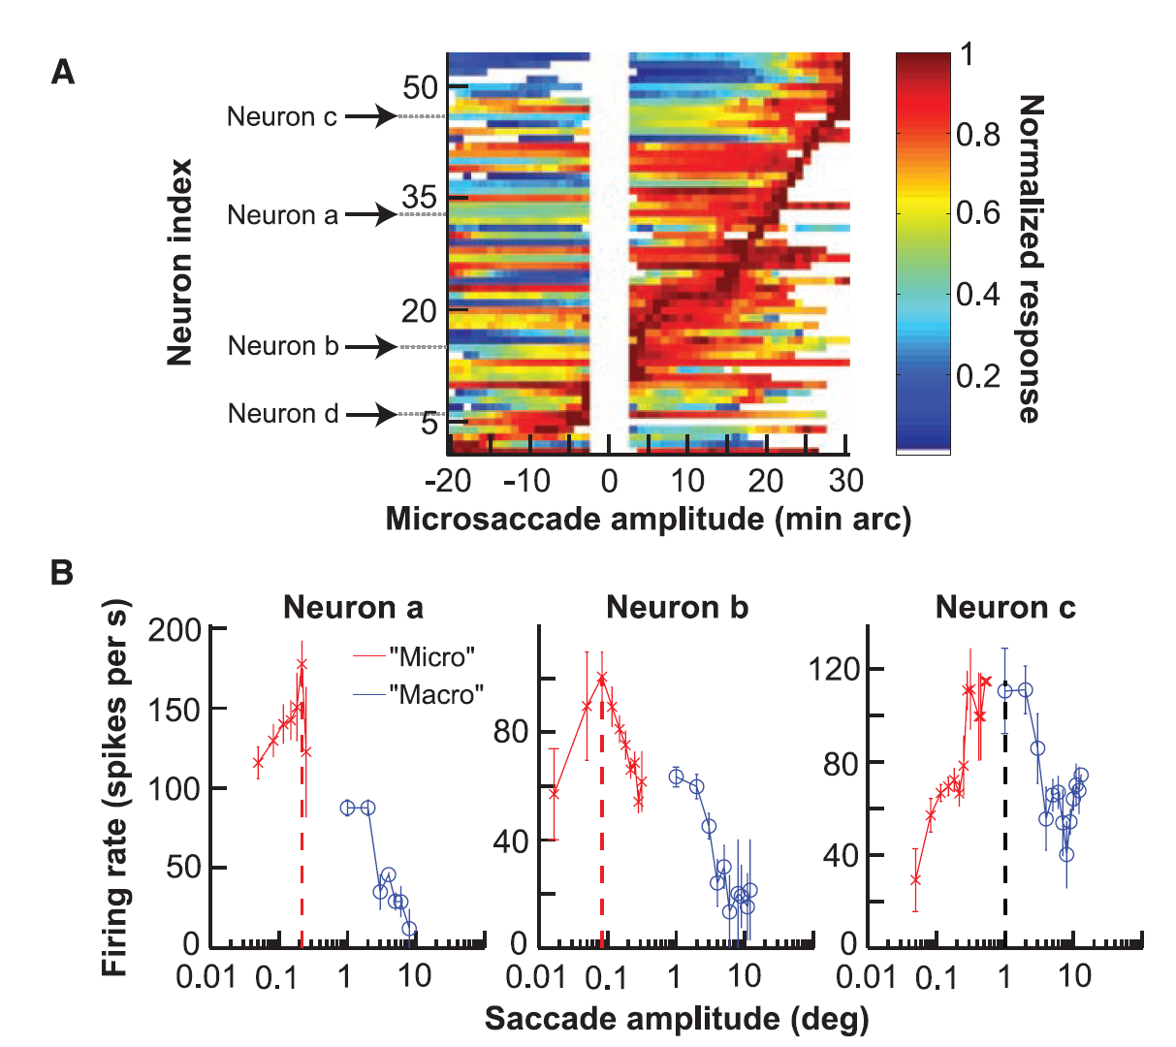
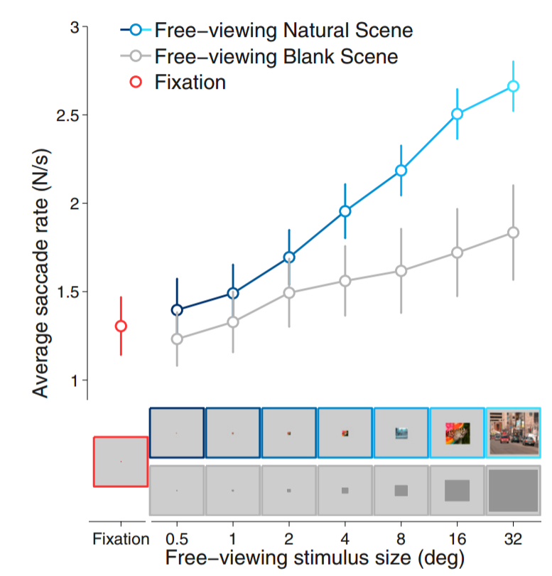
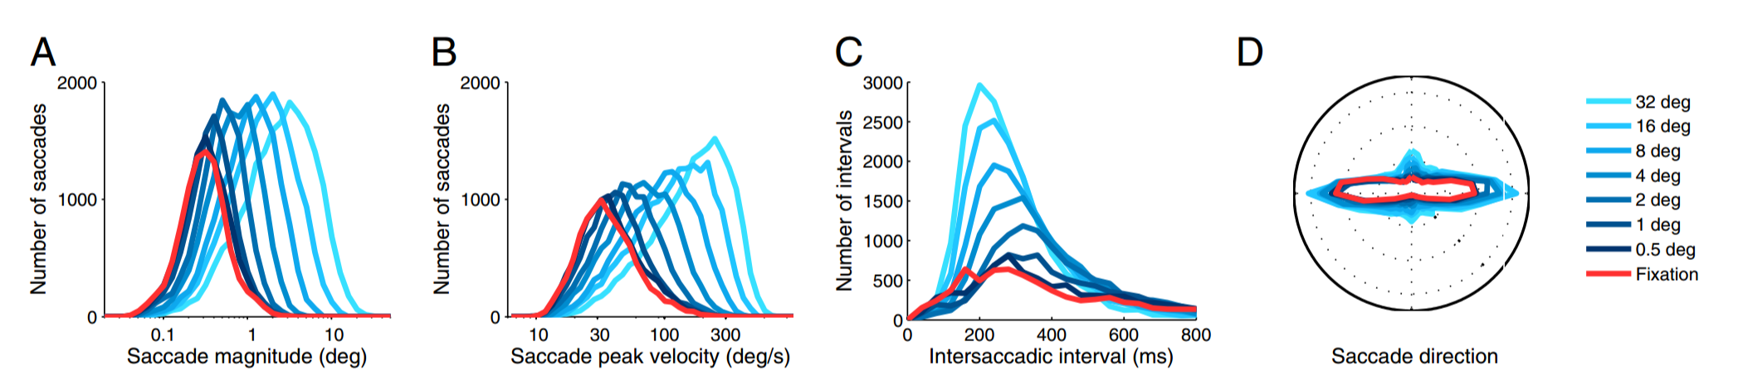
Unifying micro and macro-saccade
Hafed et al. 2008-2016
Micro saccades are not different from Macro saccades
Both generated/controlled by the SC
Otero-Millan at al. 2008-2013
Micro saccades are not different from Macro saccades
Continuum from fixational movement to free viewing

Slide 14
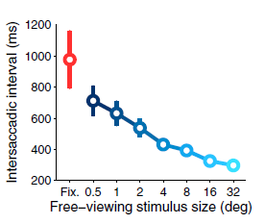
Unifying micro and macro-saccade
So why ignoring small saccades? In DINASAUR, small saccades were:
Not well distributed in time (Too many)
Not well distributed in space? (centred on zero)
Messing up the trials (accounting for one saccade per trial)

Slide 15
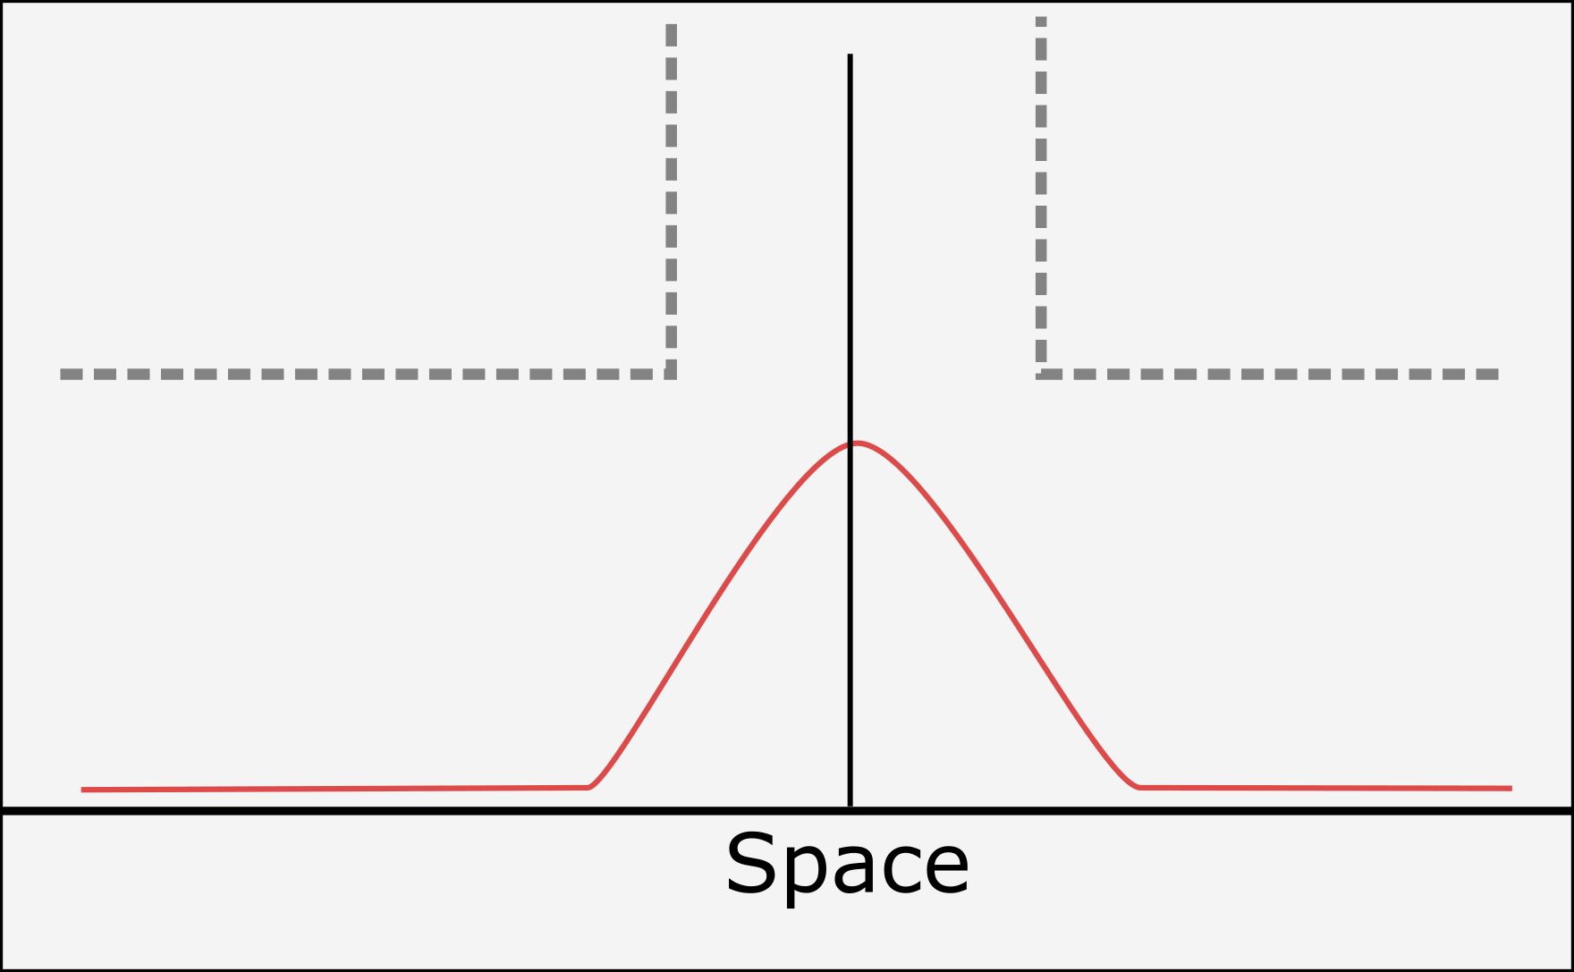
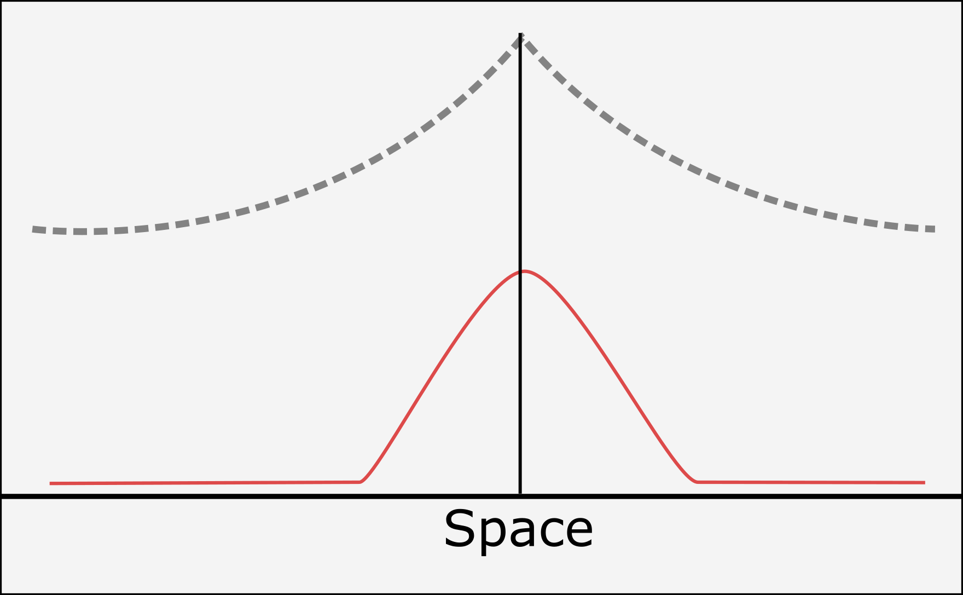
Unifying micro and macro-saccade
not well distributed in space
DINASAUR in Annie’s experiment
Exponential Threshold

Slide 16
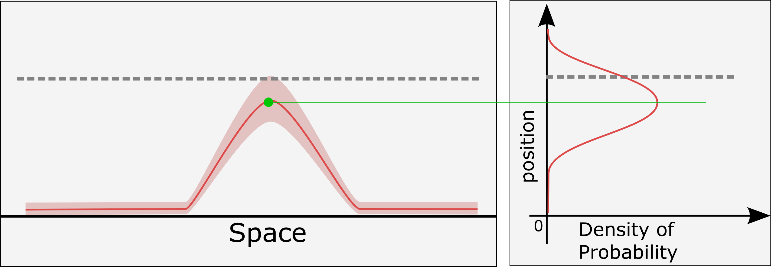
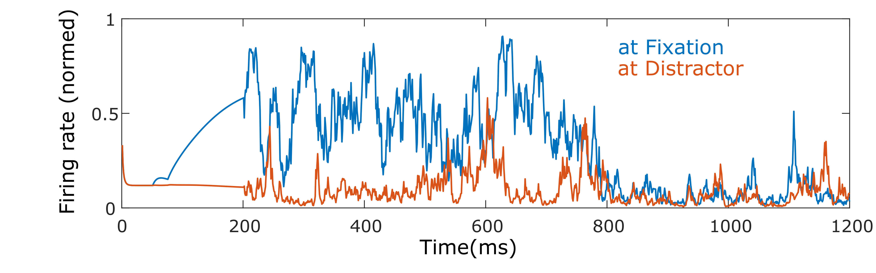
Unifying micro and macro-saccade
- not well distributed in time
Noise in DINASAUR
- Difficult to control of the probability to trigger a saccade
- Noise interacts with the mutual excitation/inhibition interactions

Slide 17
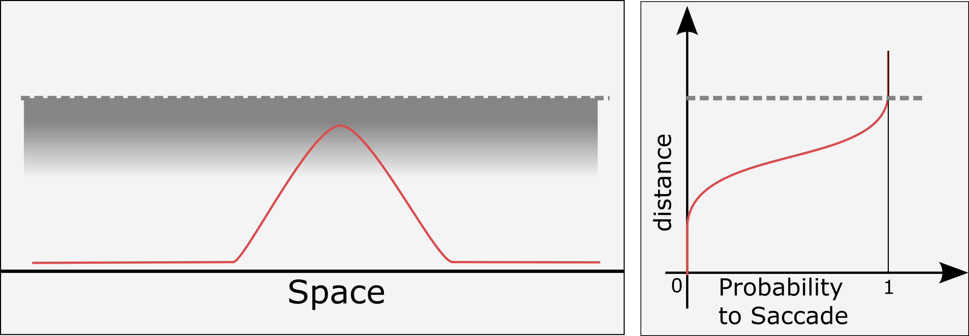
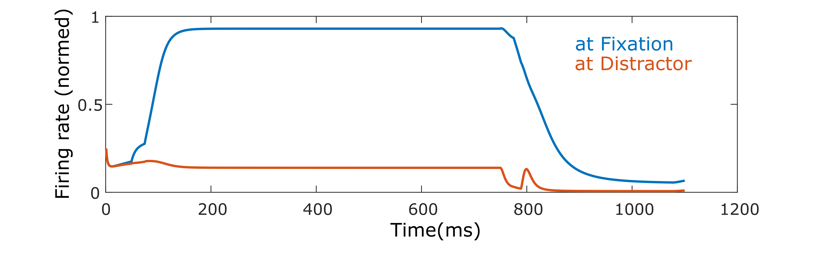
Unifying micro and macro-saccade
- not well distributed in time
Stochastic Threshold
- Used as a general model of noise for fitting neuron models
- Direct control of the probability to trigger a saccade
- Noise is independent from stimulus interactions
(note the small effect of Distractor)

Slide 18
Unifying micro and macro-saccade
not well distributed in time
not well distributed in space
Stochastic Threshold
Exponential Threshold

Slide 19
Unifying micro and macro-saccade
Distribution in space (Caution! We’re using the stochastic threshold for simpler simulations)

